Slide 1
Ref response plots

Slide 2
1. Triangle Mesh Neck Renders
1.2 Necks in different sized vesicles

Slide 3
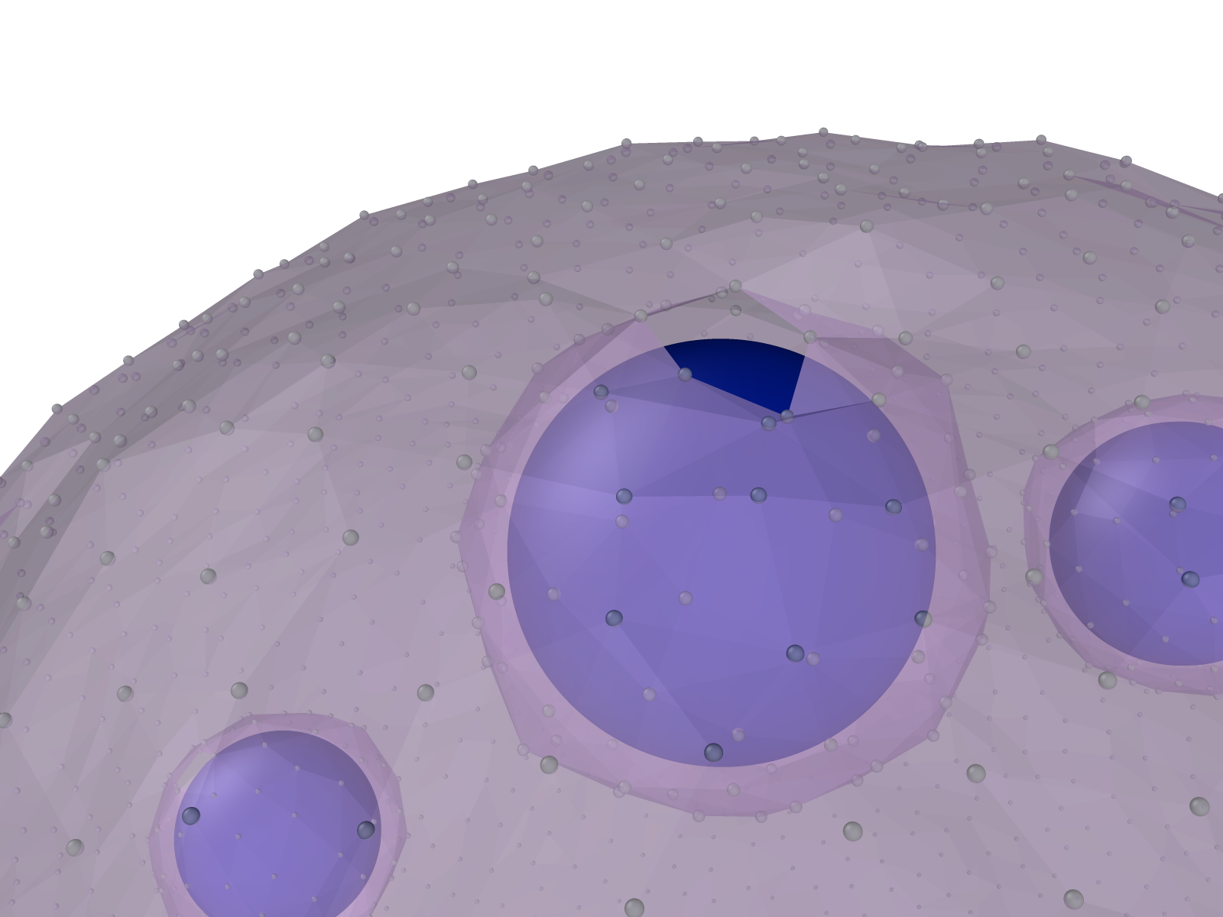
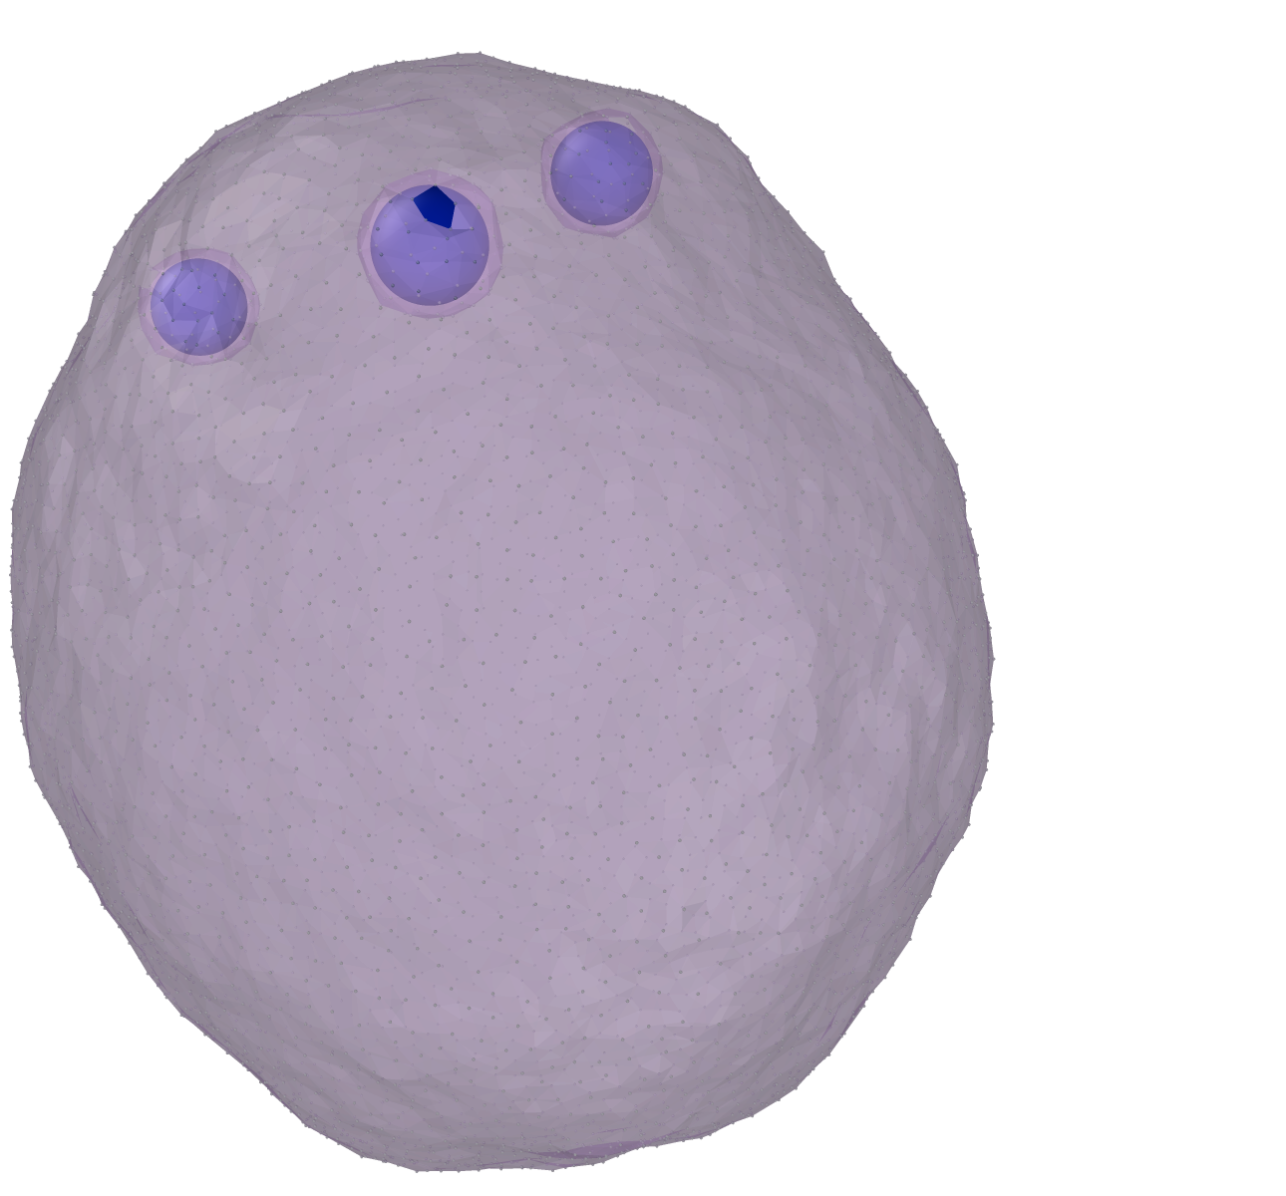
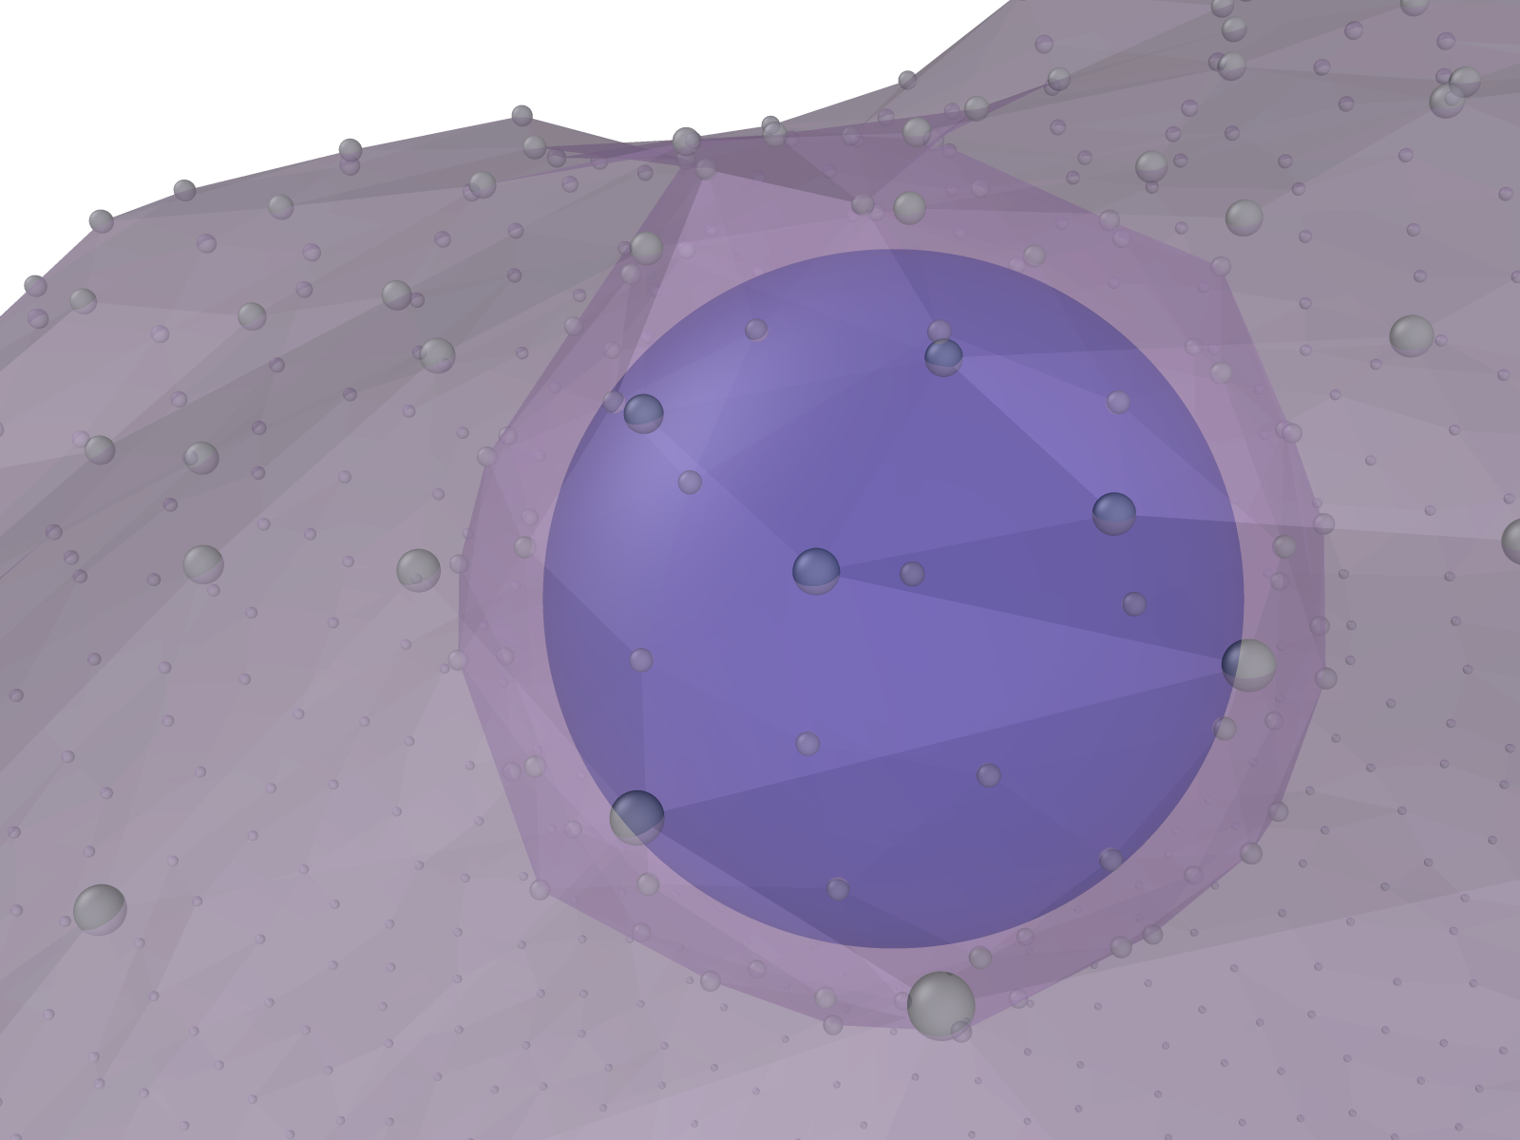
Triangle mesh at the tight neck
Zoom
Zoom across-view

Slide 4
2. Different sized vesicles with neck

Slide 5
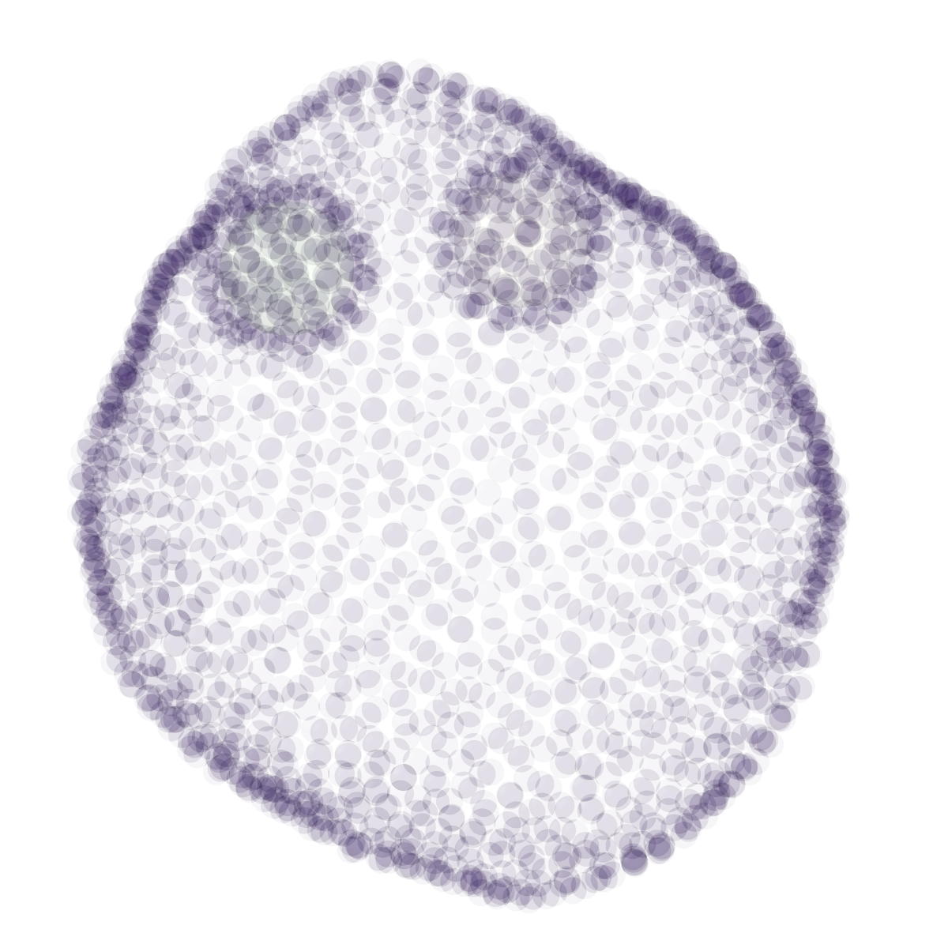
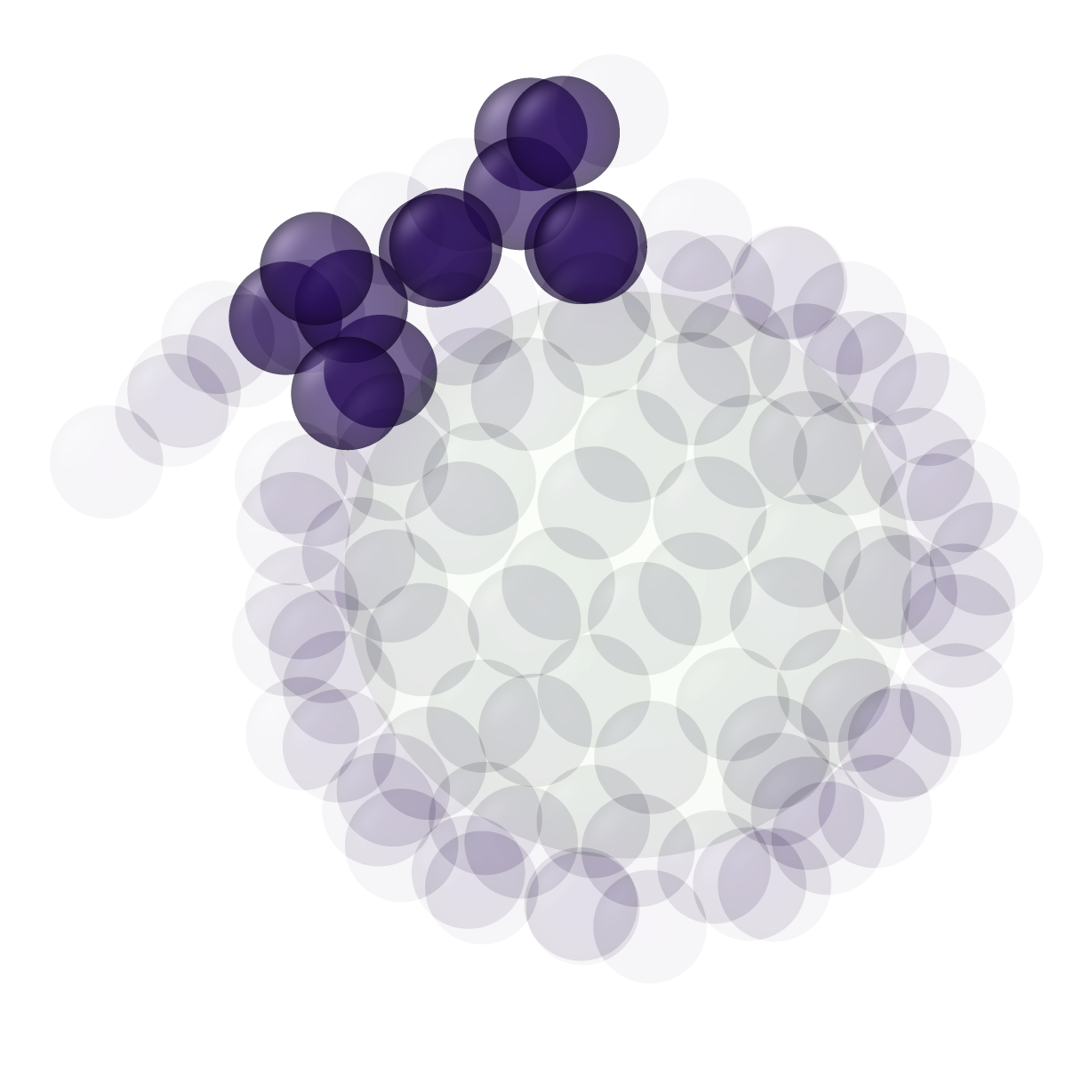
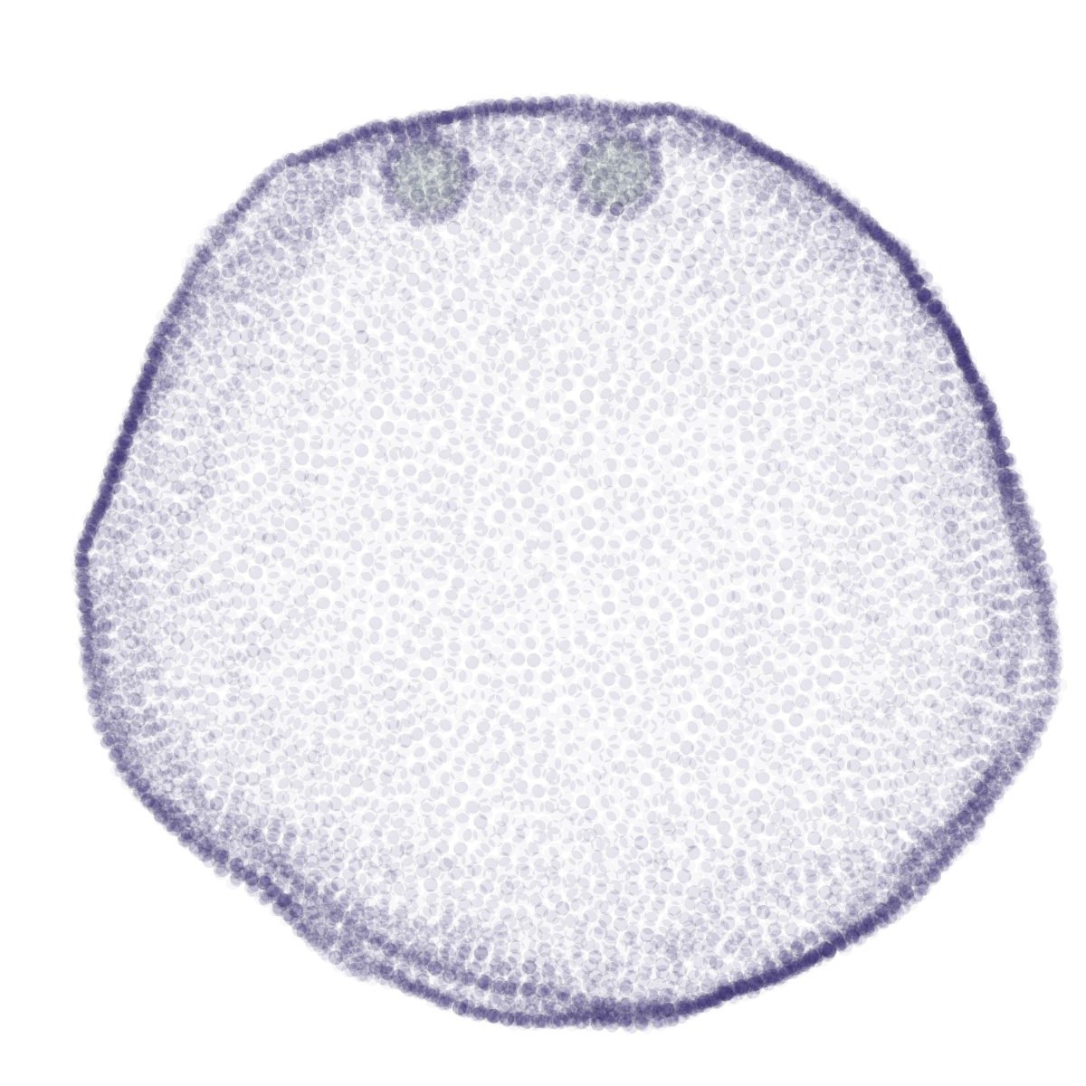
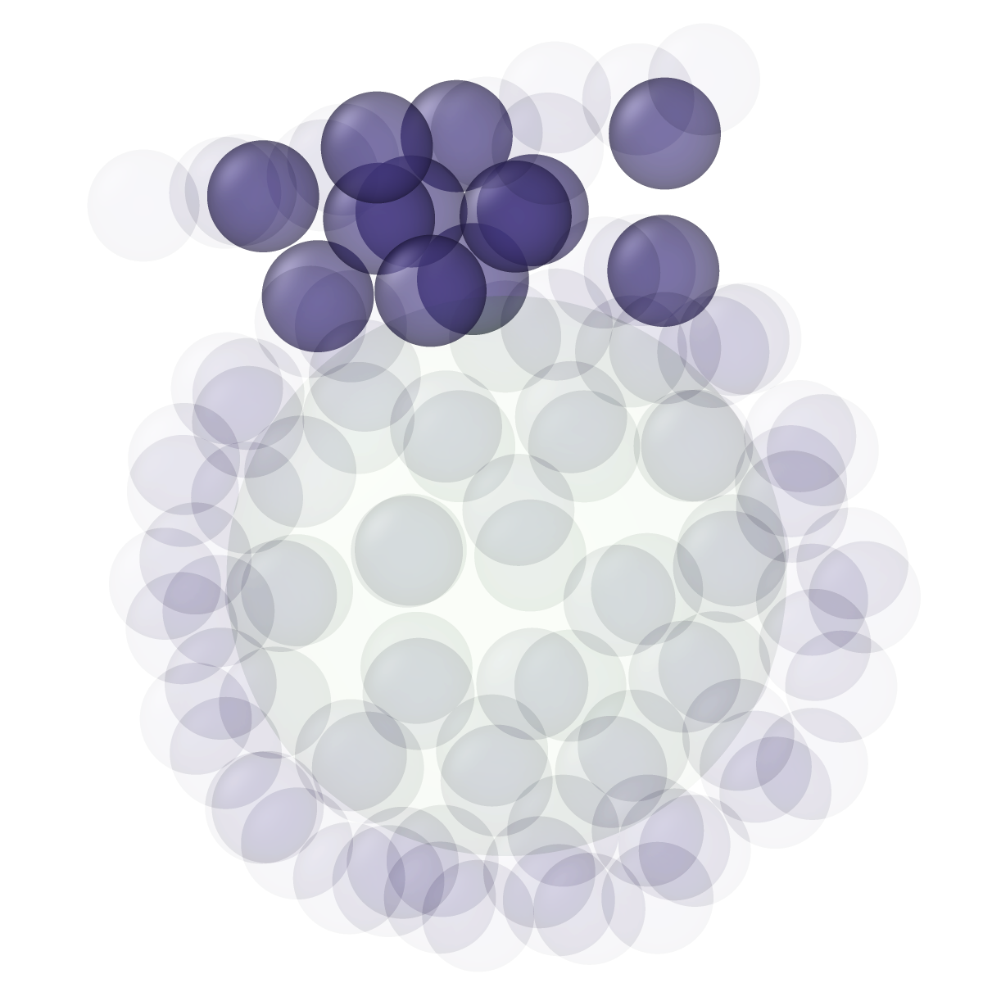
1922 membrane beads
9722 membrane beads

Slide 6
3. Histogram of energy partitioning for 2 beads

Slide 8
4. Ashfin’s data in the SI figure

Slide 9
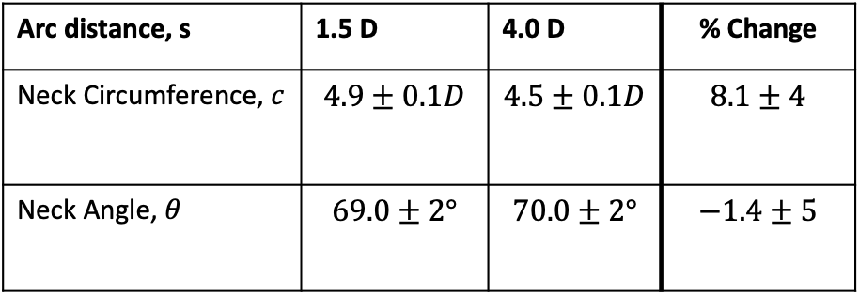


Neck Circumference
Neck Angle
$$θ$$
Arc distance, s | 1.5 D | 4.0 D | % Change
Neck Circumference, $c$ | $$4.9±0.1D$$ | $$4.5±0.1D$$ | $$8.1±4$$
Neck Angle, $θ$ | $$69.0±2°$$ | $$70.0±2°$$ | $$−1.4±5$$
$$c$$

